Slide 1


ONBOARDING UI

Slide 2


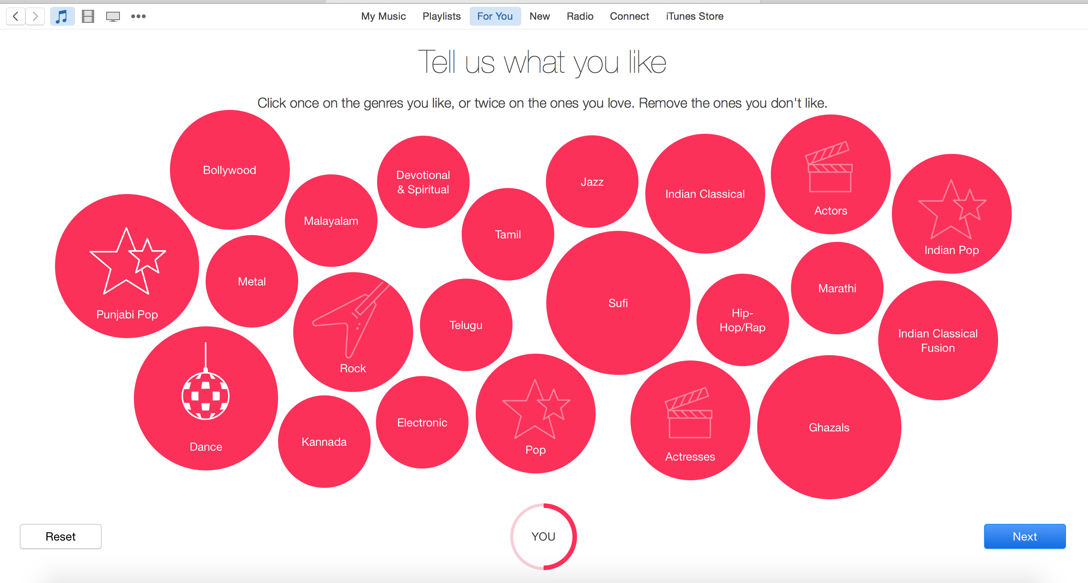
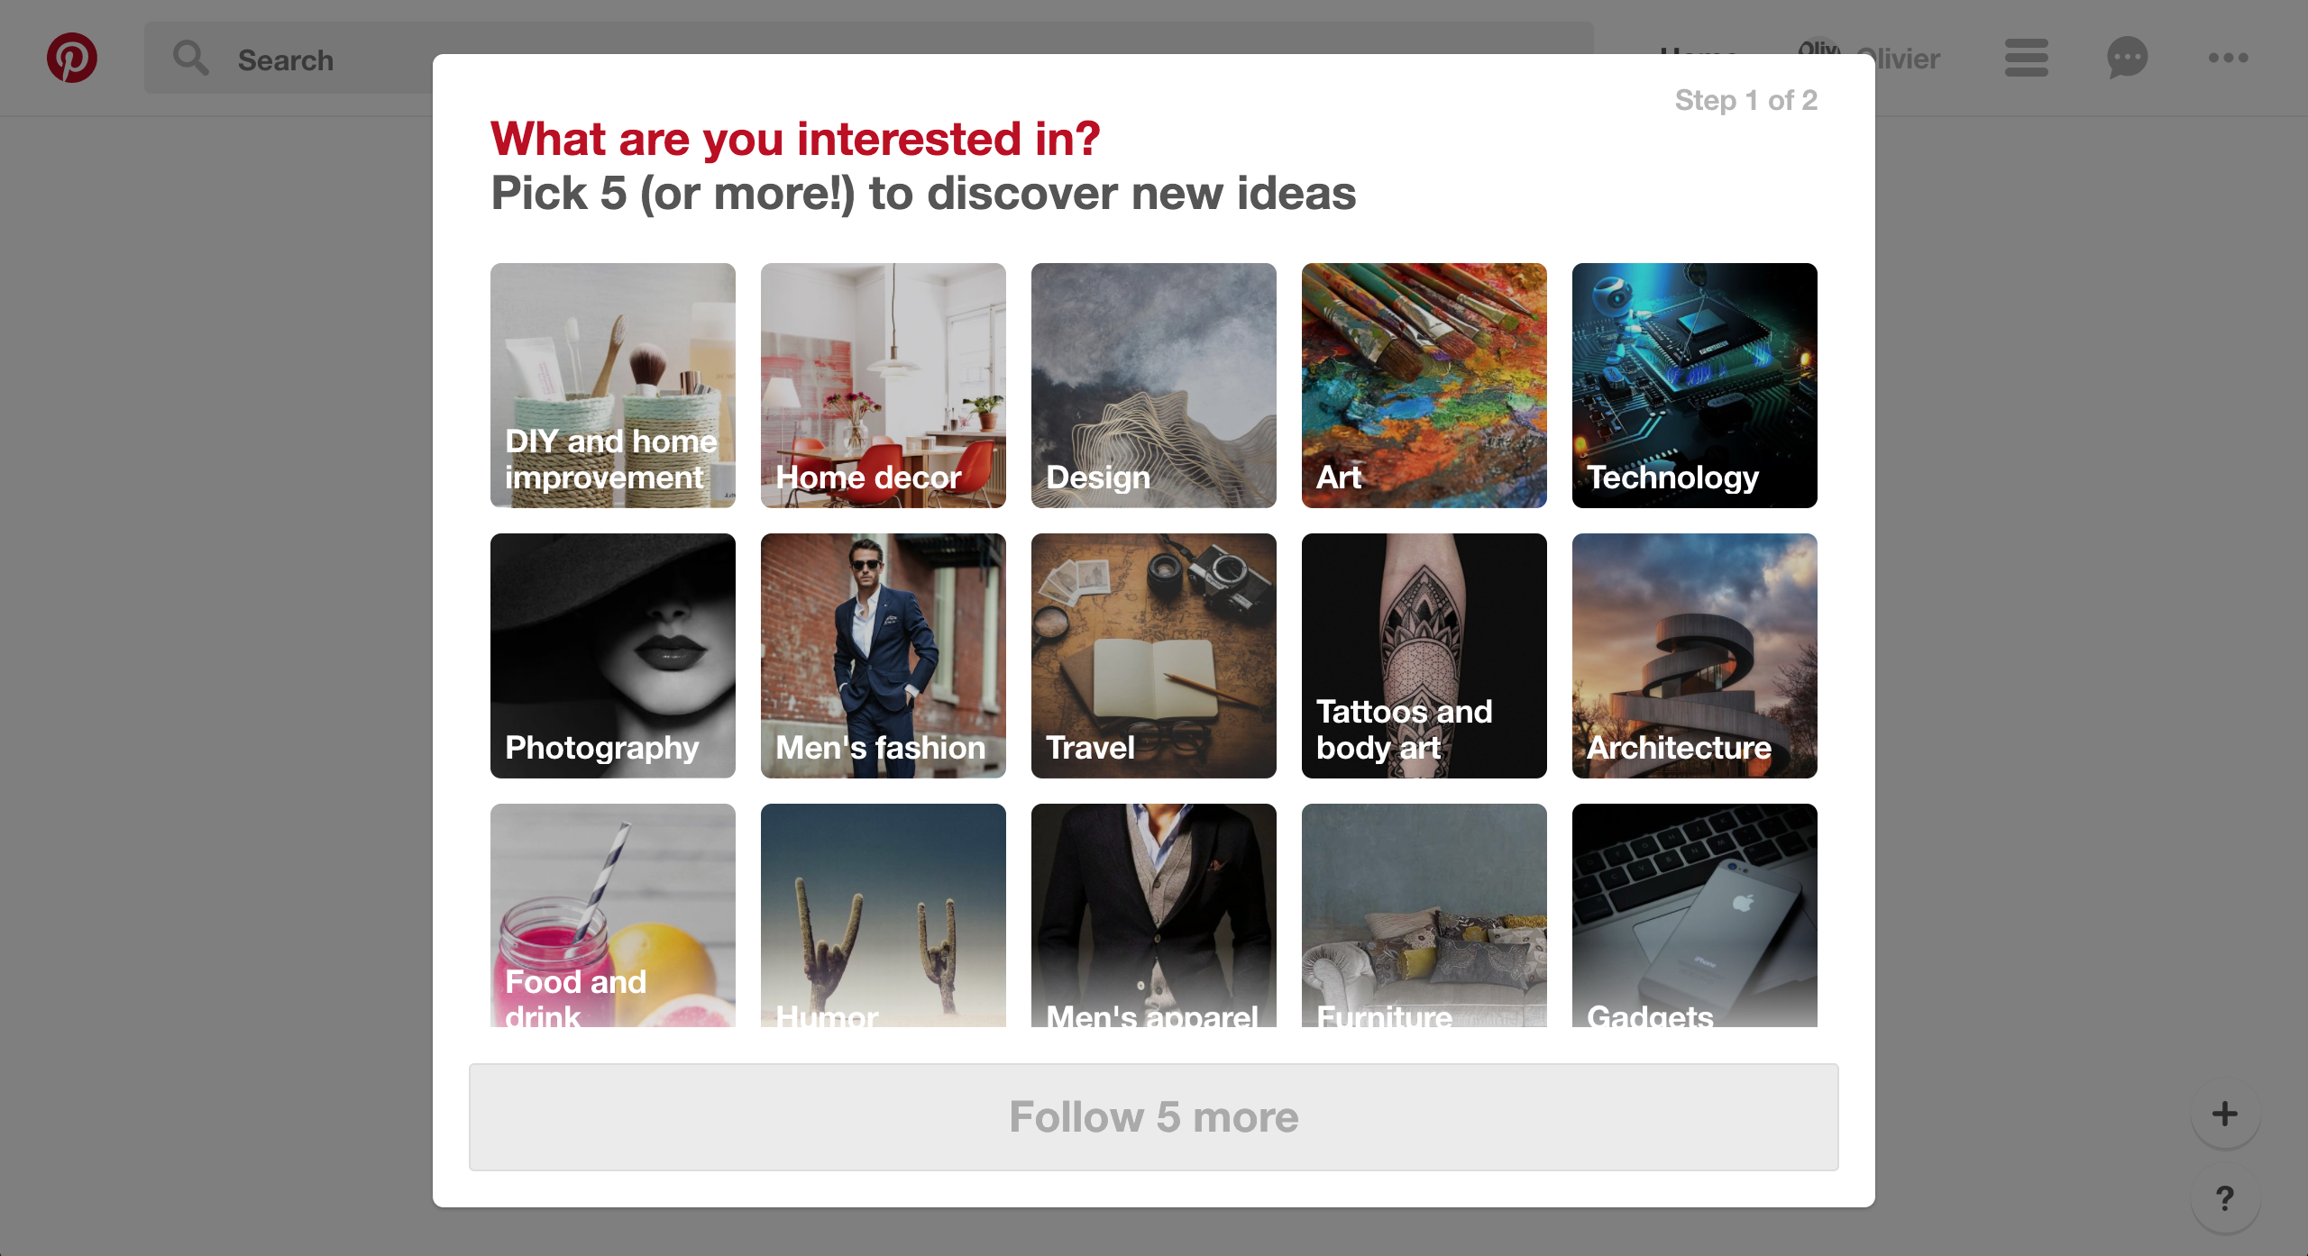
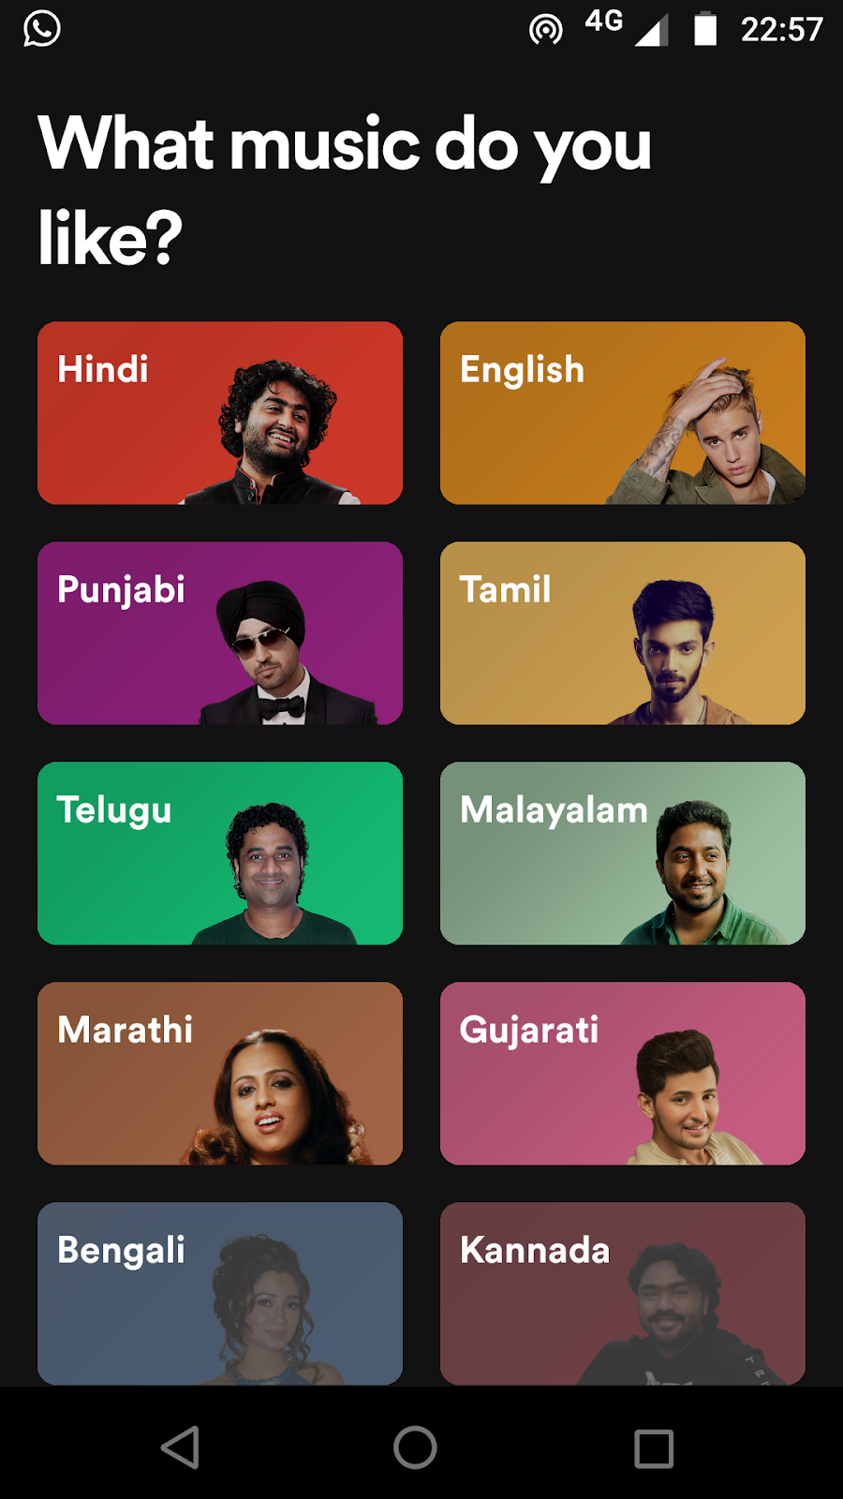
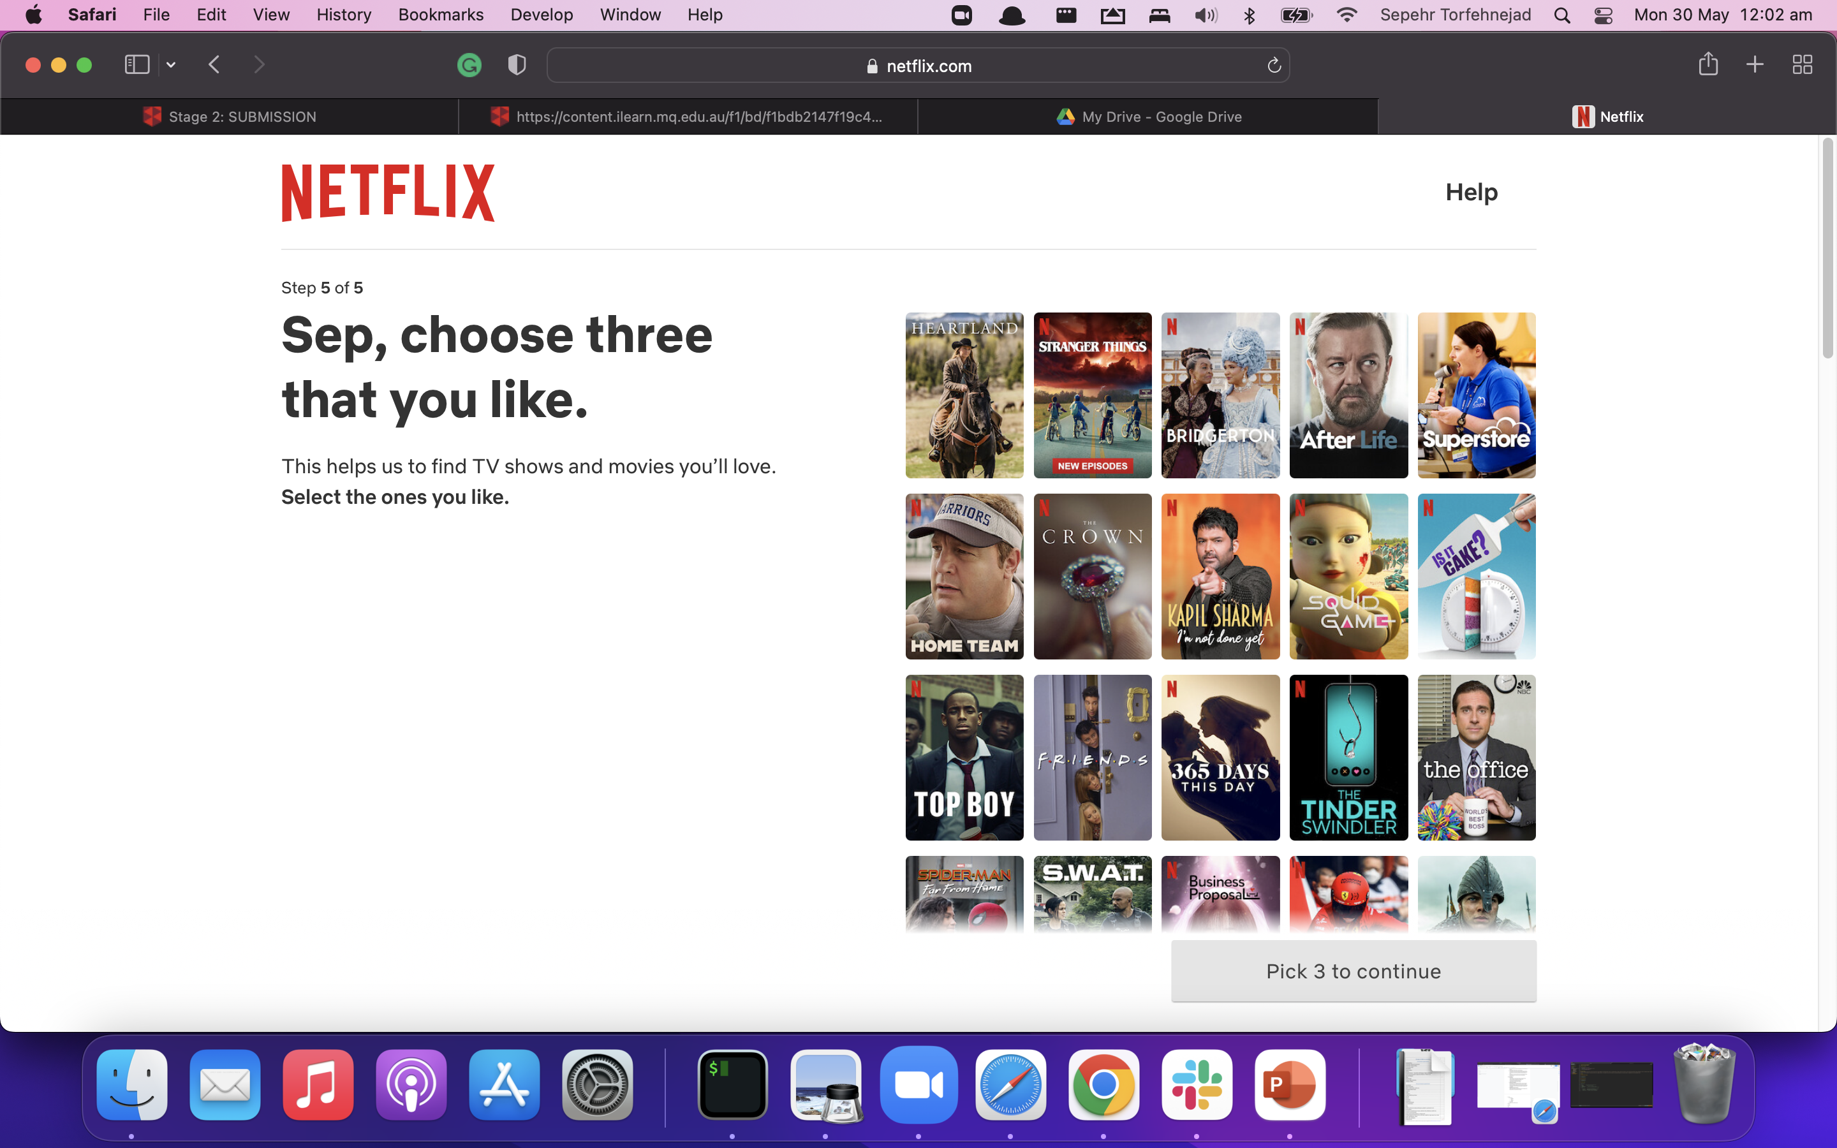
| Onboarding, it’s everywhere!
Lance Te

Slide 3
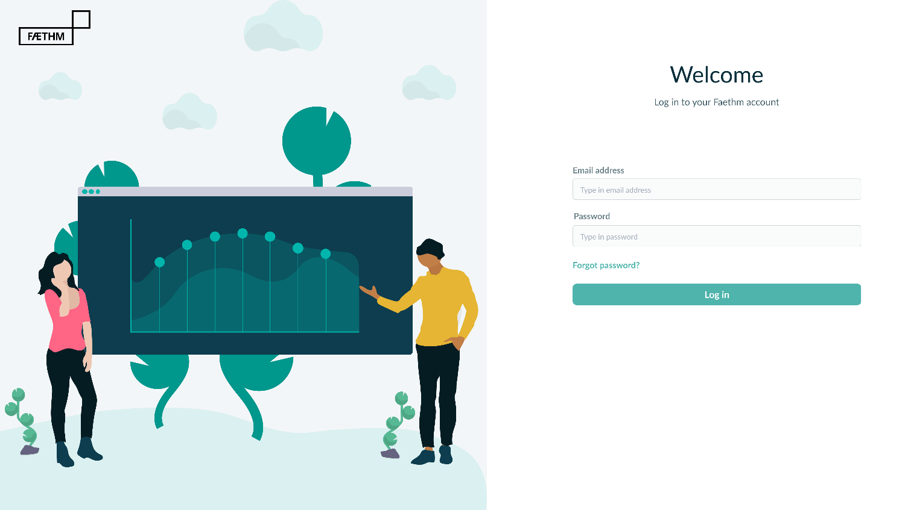
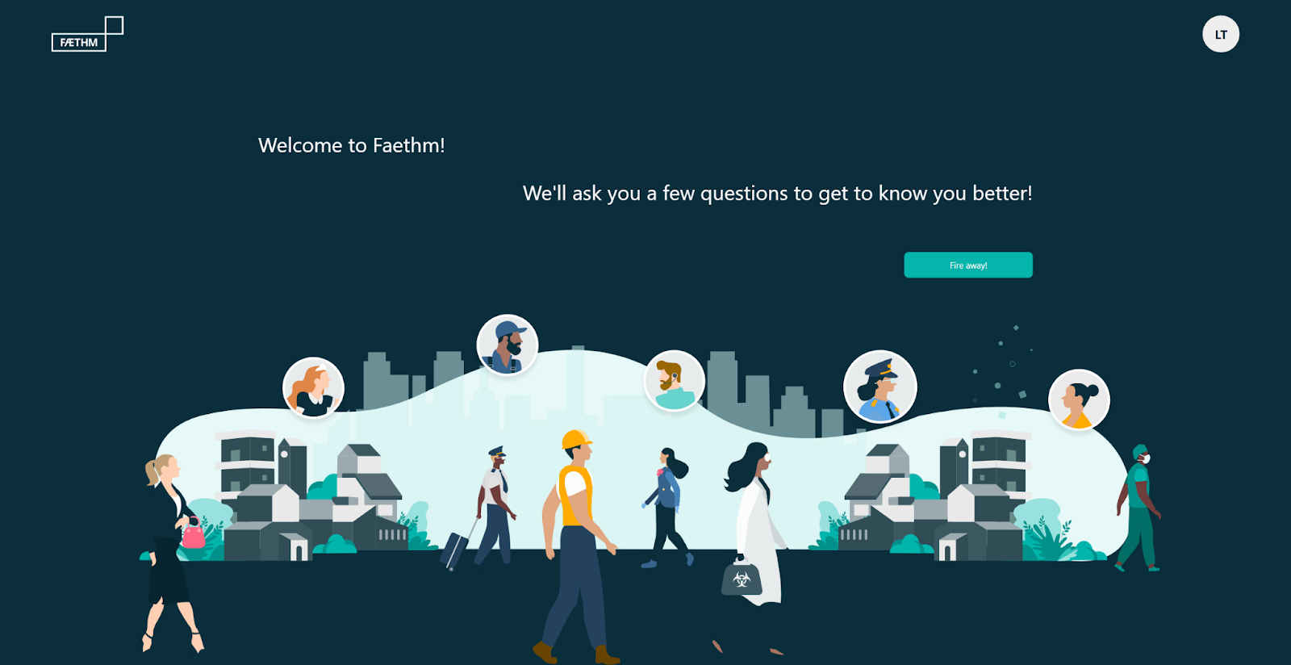
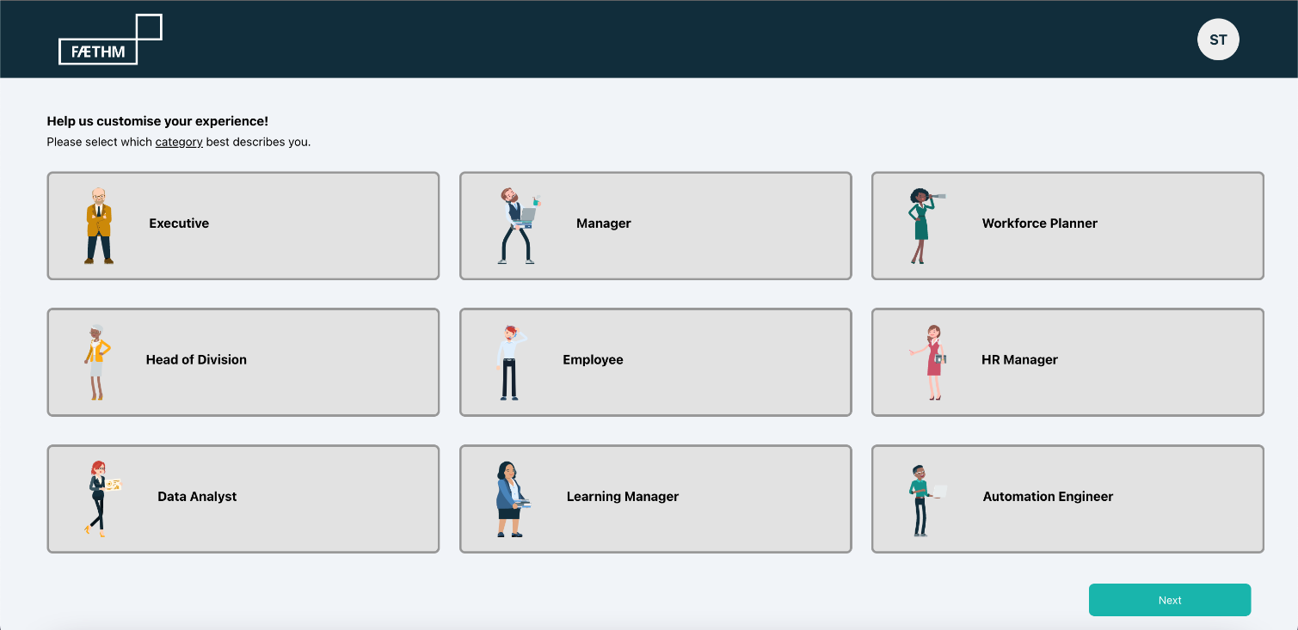
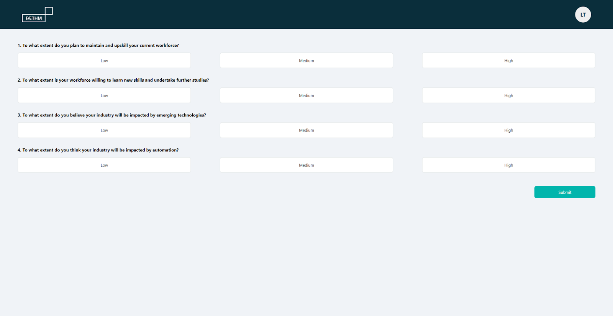
| Onboarding UI
Lance Te

Slide 4

| Problem
“
To enhance their onboarding application by implementing some additional data-driven steps
”
Erik Horvath
Notes:
To paint the big picture, Faethm AI are looking to enhance their onboarding application by implementing some additional data-driven steps.
These steps will provide users with the opportunity to customise their experience by providing certain helpful information. This is the First Time User (FTU) Experience.
Alongside Faethm engineers and designers, our team will create several views in a Single Page Web Application (SPA), a web backend API and suitable prototype infrastructure to run the workload locally, and data pipeline process captured user preferences to provide a personalised experience.
The FTU Experience must capture a username and occupation (from our list of valid occupations), and trigger the completion of a short survey that will ask participants about the intended use of the Faethm AI platform.
Beyond that, we had university obligations, in the form of deliverables, that were due throughout.

Slide 5
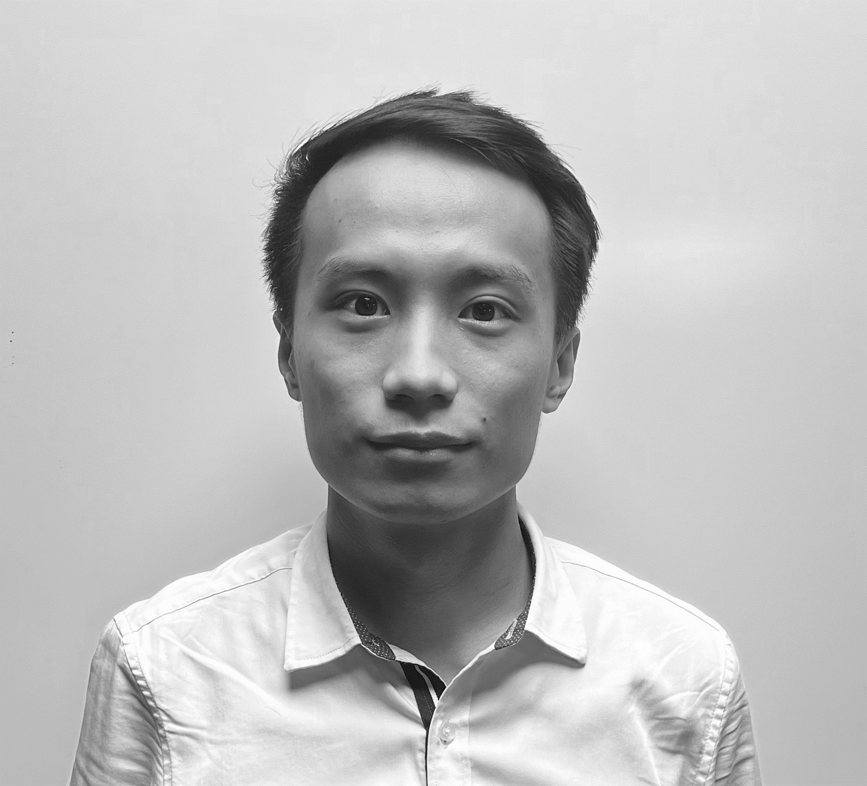
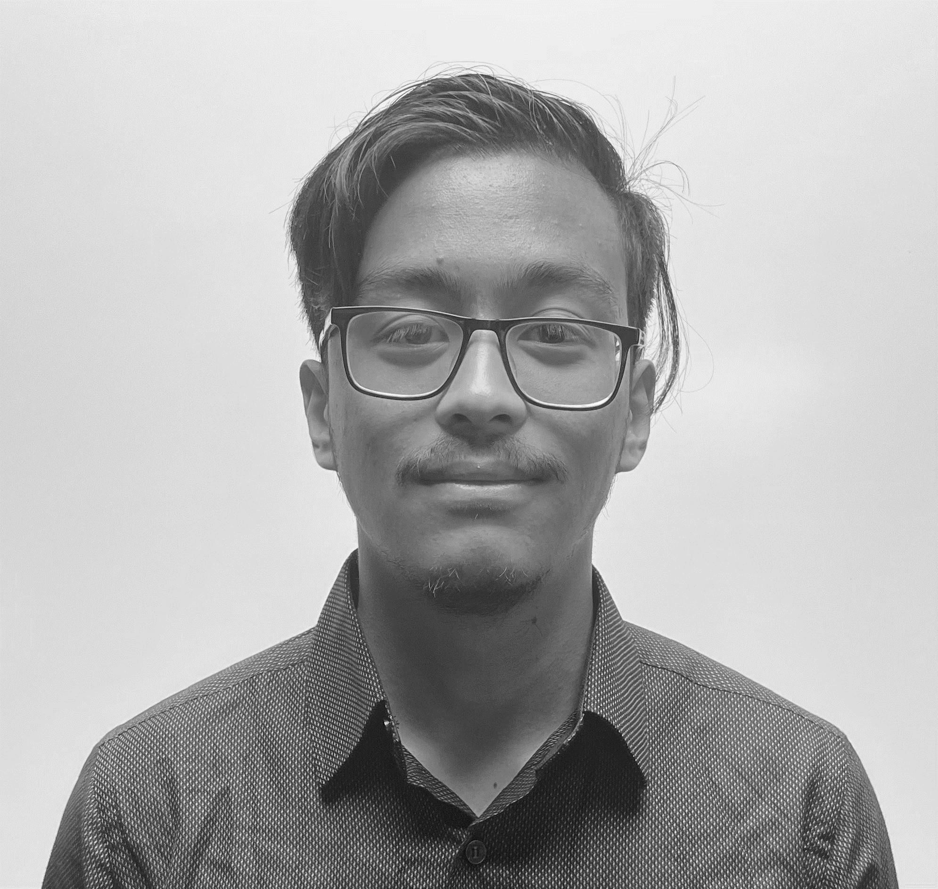
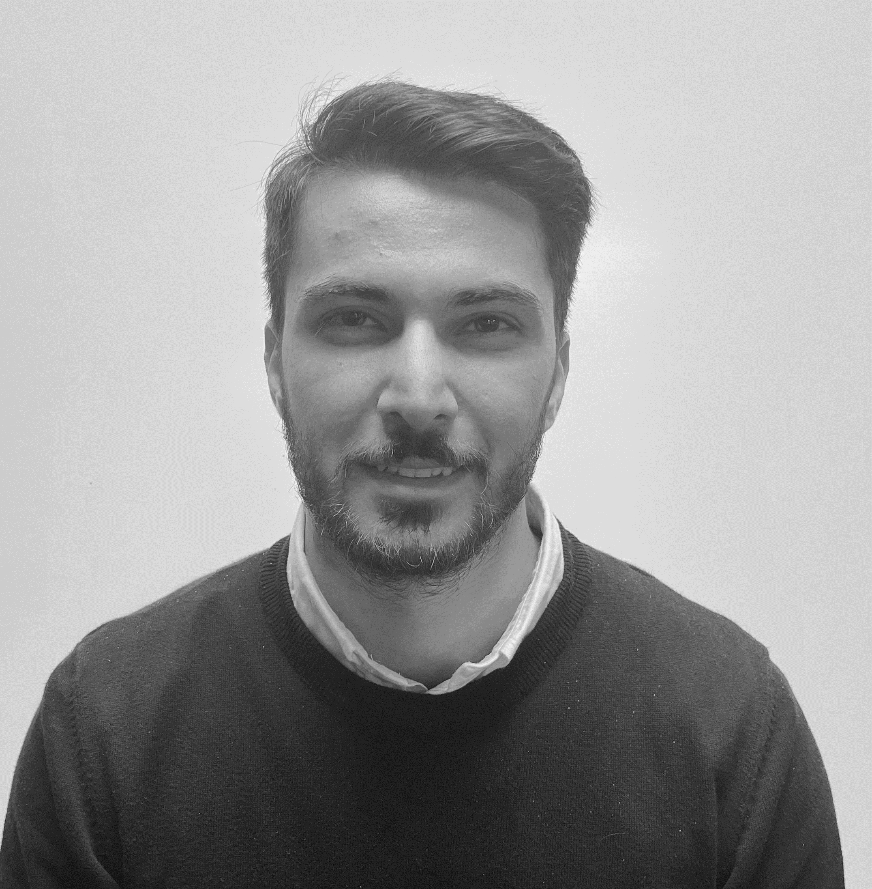

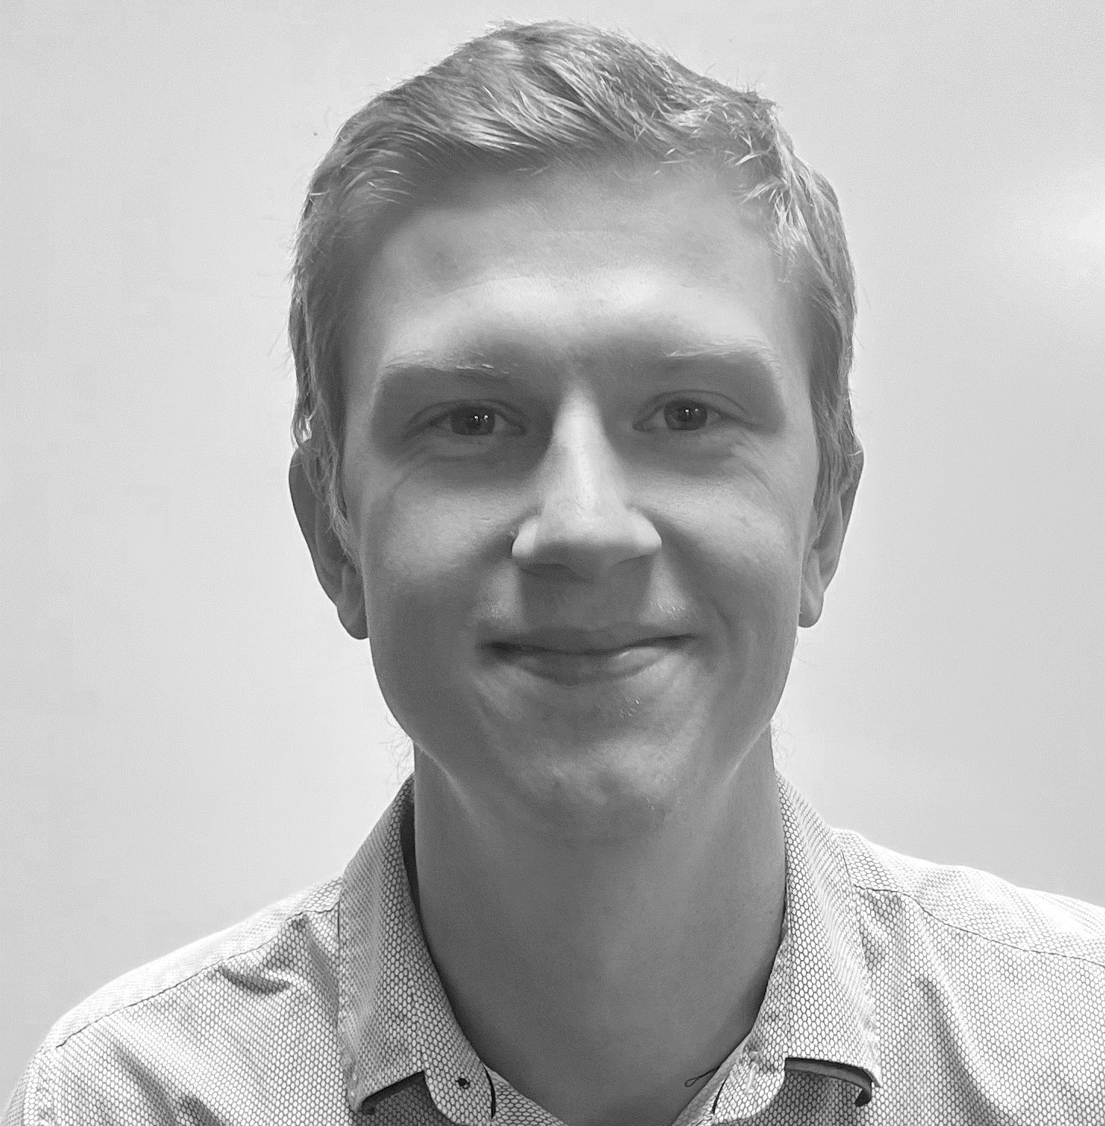
| Our Team
Lance Te
Team Lead – Developer – Docs Support
Rojwal Shrestha
Docs Officer
Sepehr Torfeh Nejad
Lead Developer – Docs Support
Marcus Ikeda
Docs Officer
Erik Horvath
Docs Officer – Editor
Erik Horvath
Notes:
We decided that breaking up the team into these roles would be the most effective way to utilise the team's strengths and ensure that there was a sense of accountability within the team.

Slide 6
| Agile Process
MEET
EVALUATE
PLAN
TEST
DESIGN
DEVELOP
Marcus Ikeda
Notes:
Next, we had to choose a methodology. The problem fell under the software development umbrella and thus we reasoned and settled on the agile methodology.
The agile method allowed Faethm to maintain more control over the project because they are more easily able to make changes to the software requirements.
I will pass on to Roj now who will elaborate further on how the team took advantage of the agile process to ensure collaboration and an iterative approach.

Slide 7
| Agile Process
Weekly team meetings every Wednesday
Weekly client meetings every Wednesday
MEET
EVALUATE
PLAN
TEST
DESIGN
DEVELOP
Rojwal Shrestha

Slide 8
| Agile Process
Weekly team meetings every Wednesday
Weekly client meetings every Wednesday
Task allocation
Setting up collab tools
MEET
EVALUATE
PLAN
TEST
DESIGN
DEVELOP
Rojwal Shrestha

Slide 9
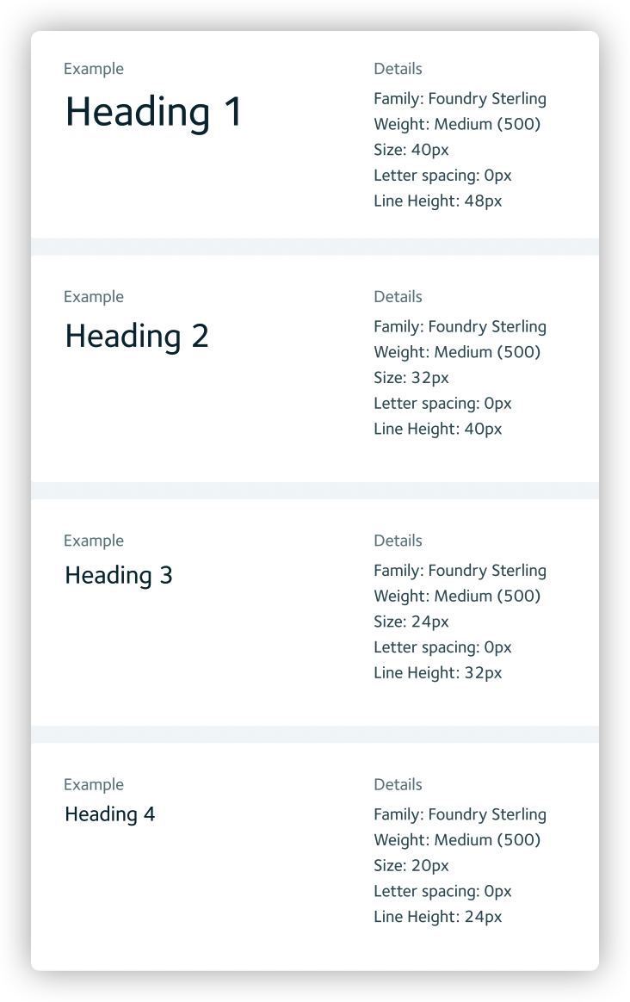
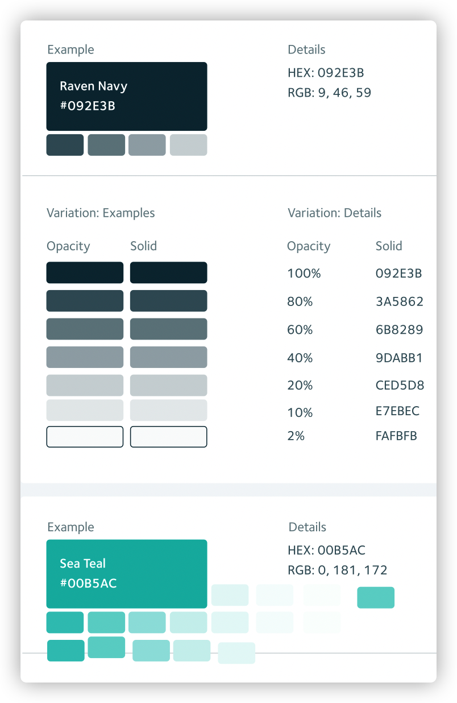
| Agile Process
Typography
Color Scheme
Task allocation
Setting up collab tools
Using Faethm’s existing CSS
Figma mock up
Feedback
MEET
EVALUATE
PLAN
TEST
DESIGN
DEVELOP
Rojwal Shrestha

Slide 10






| Agile Process
Using Faethm’s existing CSS
Figma mock up
Feedback
Frontend:
MEET
EVALUATE
PLAN
Backend:
TEST
DESIGN
express
DEVELOP
Rojwal Shrestha

Slide 11
| Agile Process
Frontend:
Establishing tests
Deciding / assigning appropriate testers
Make changes and repeat
MEET
EVALUATE
PLAN
Backend:
TEST
DESIGN
express
DEVELOP
Rojwal Shrestha

Slide 12
| Agile Process
Establishing tests
Deciding / assigning appropriate testers
Make changes and repeat
Client demos
Gather feedback
Apply feedback
MEET
EVALUATE
PLAN
TEST
DESIGN
DEVELOP
Rojwal Shrestha

Slide 13
| Agile Process
Client demos
Gather feedback
Apply feedback
Repeat
MEET
EVALUATE
PLAN
TEST
DESIGN
DEVELOP
Rojwal Shrestha

Slide 14
| Demo
A screen-recorded demonstration
Sepehr Torfeh Nejad

Slide 15
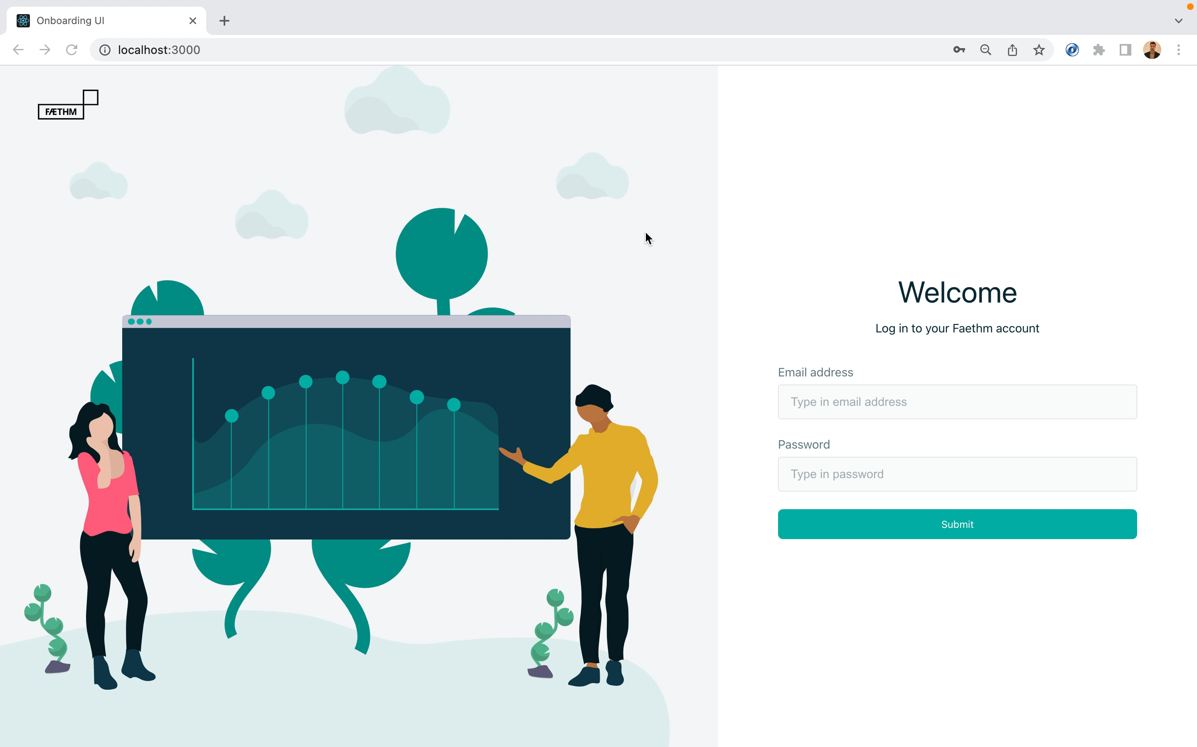
Sepehr Torfeh Nejad

Slide 16
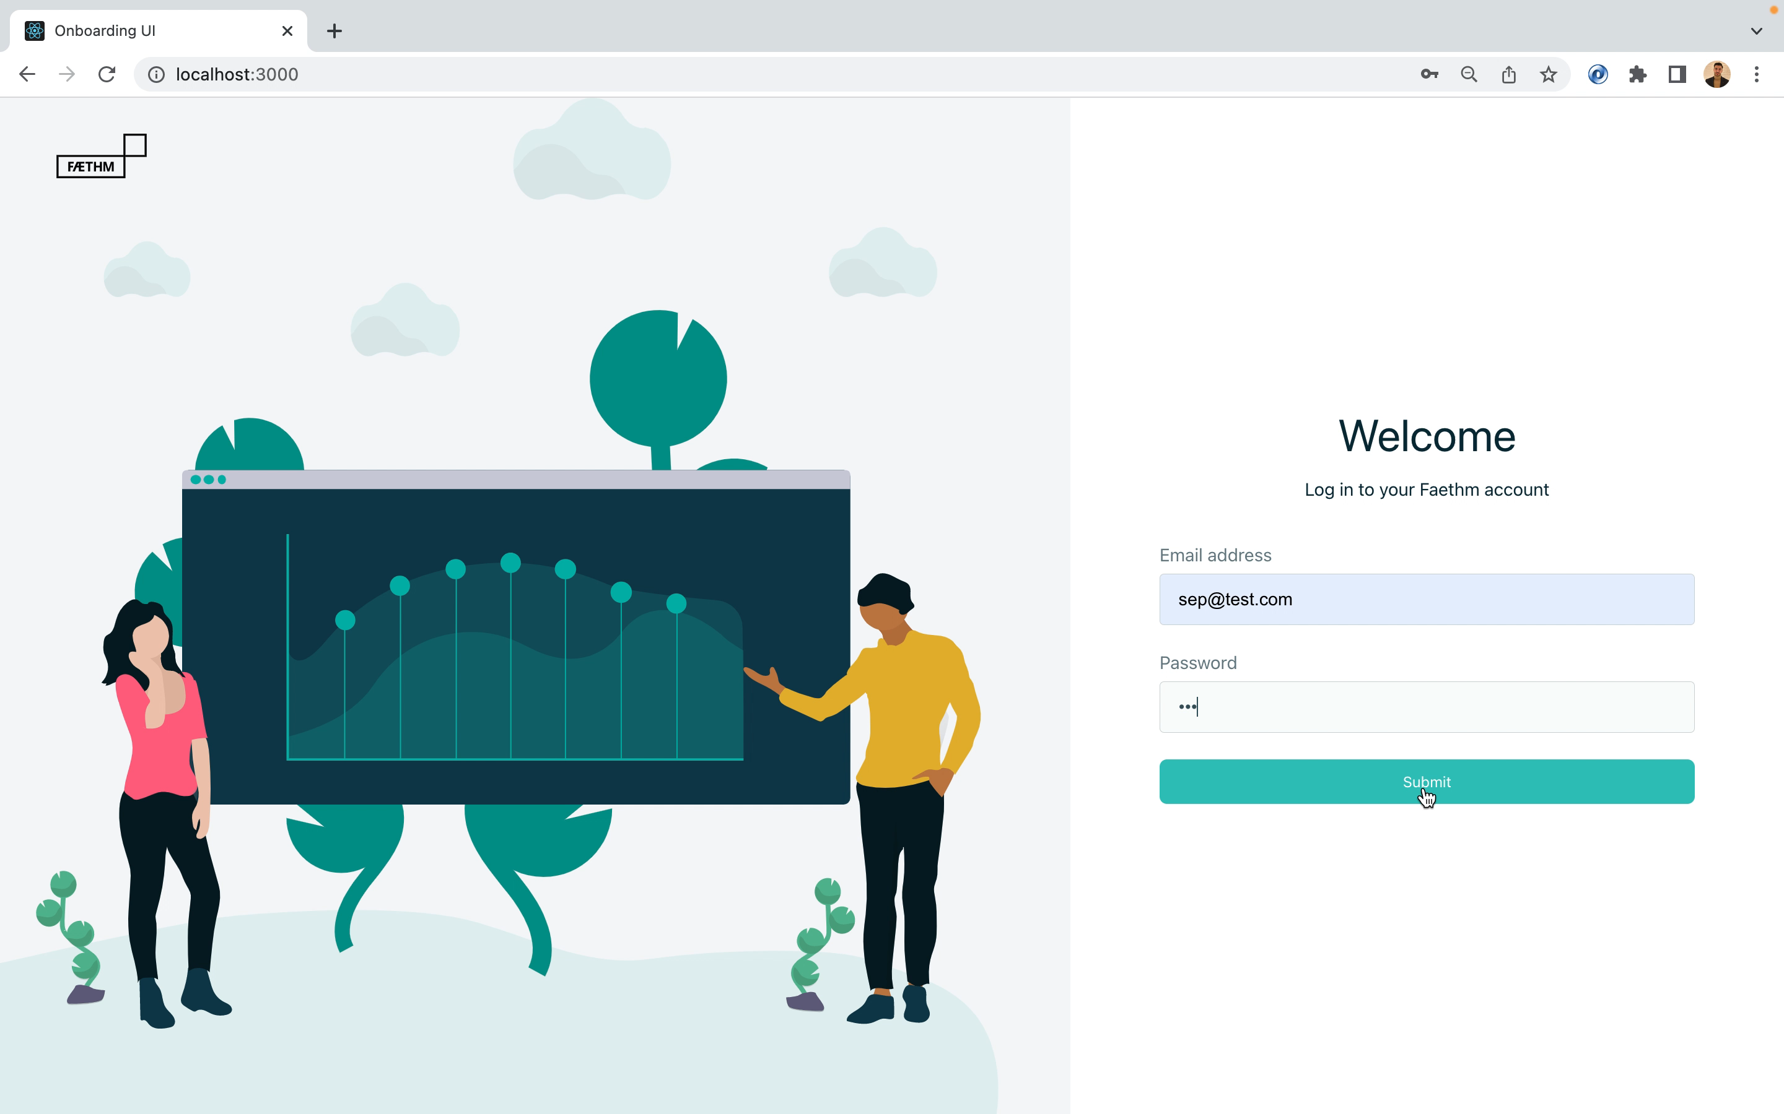
Sepehr Torfeh Nejad

Slide 17
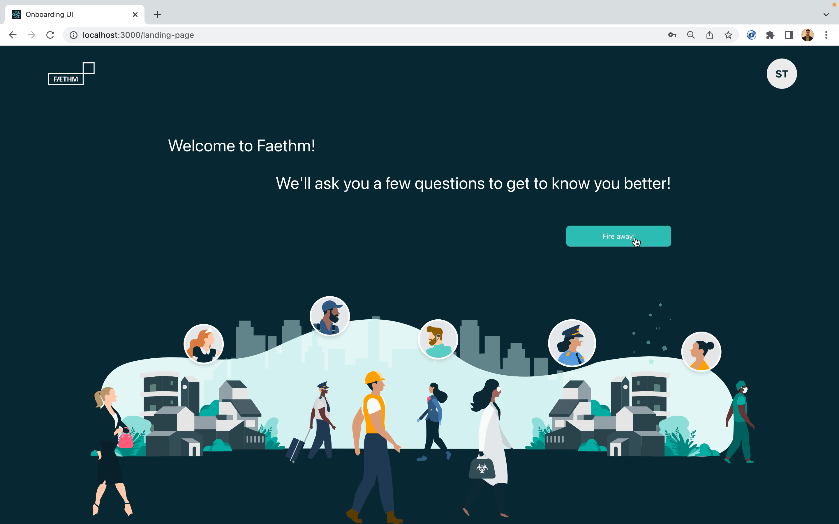
Sepehr Torfeh Nejad

Slide 18
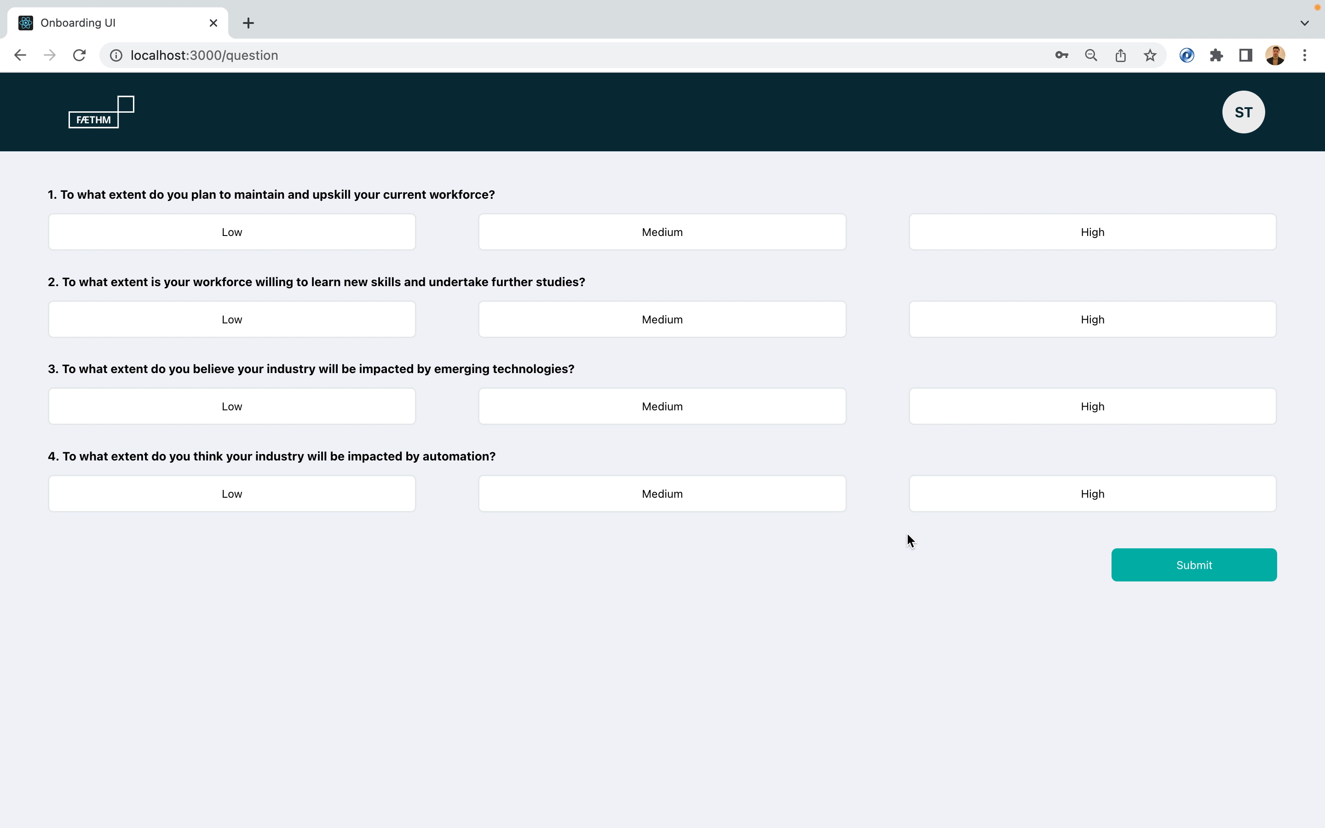
Sepehr Torfeh Nejad
Notes:
- For example, high, high, low, low can indicate the user is likely to consider retraining their staff as a viable option.

Slide 19
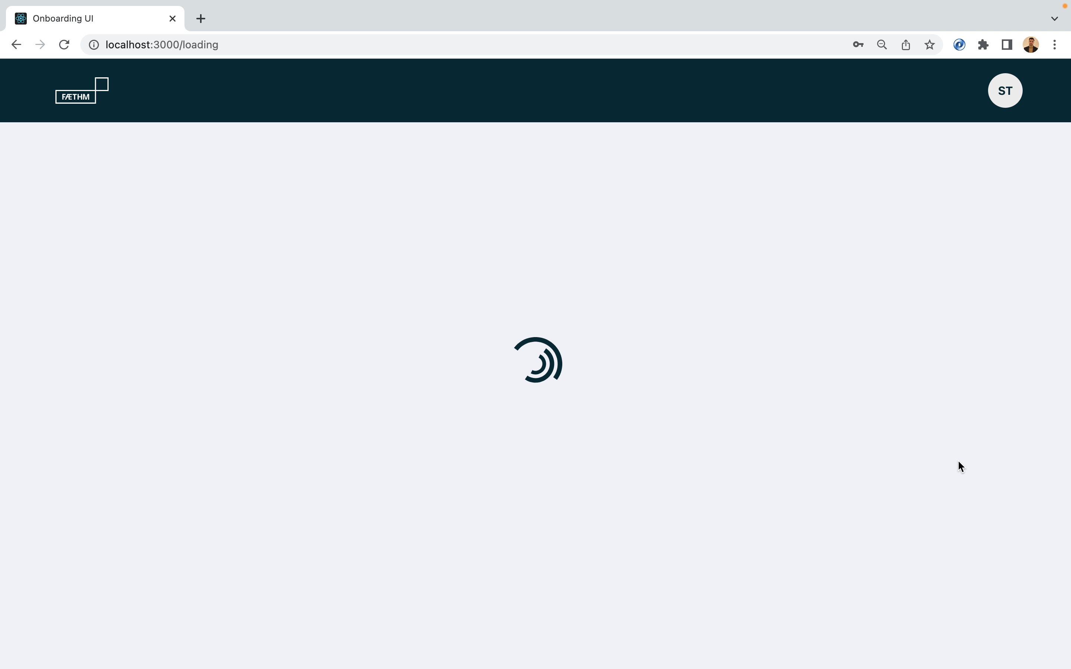
Sepehr Torfeh Nejad
Notes:
- Restate: The articles / recommended for you are personalised based on the user’s choice of persona and intended use-case.

Slide 20




| Future Work
Using Docker
Better survey questions
Refine survey algorithm
Refactor code
Build CSS from scratch
Deploy application on the cloud
Erik Horvath

Slide 21

| Reflection
Sharing knowledge
Valuable experience
Collaborative environment
Stay organised!
Erik Horvath

Slide 22
| Questions?
We welcome your questions

Slide 23



TECHPAD TECHNOLOGIES
Launching your ideas
/techpad_tech

